Slide 1
IDM for U G
Department of Fashion Technology
(DFT)
NIFT New Delhi

Slide 2
Top Technology Trends Reshaping The Fashion Industry in 2023
Artificial intelligence
Novel fabrics
Internet of things (IoT)
Mobile commerce
Virtual and augmented reality (VR/AR)
3D Printing
Blockchain
Sustainability

Slide 3
Projects undertaken by NIFT
National Sizing Survey of India/INDIAsize Project
  develop Indian size charts based on body measurements of Indian population for better fitting of ready to wear garments.
  plans to measure 25000 persons aged from 18 to 65 years in six different regions of India using 3D body scanners.
VISIONXT- TREND INSIGHT AND FORECASTING LAB
  plans to develop an Artificial Intelligence based deep learning model enabled to forecast fashion directions for India.
Development of E-content of Fashion Design & Technology -NMEICT / MOOC
  17 courses of 40 hours duration were completed during Phase I and uploaded in the MHRD website SWAYAM.

Slide 4
Initiatives taken by NIFT
i-SMART
  Intelligent Skill Mapping and Rating Technology (i-SMART) is world’s first and only technology that evaluates the skill of a sewing machine operator.
Shahi Chair at NIFT
  Scholarship to students for carrying out cross-disciplinary research, industry survey and benchmarking studies, execute high quality fundamental research in the area of Apparel Industry 4.0.

Slide 5
DFT is offering the following IDM to U G Students
IT Applications
for Fashion Business

Slide 6
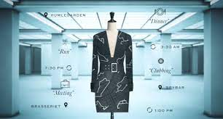
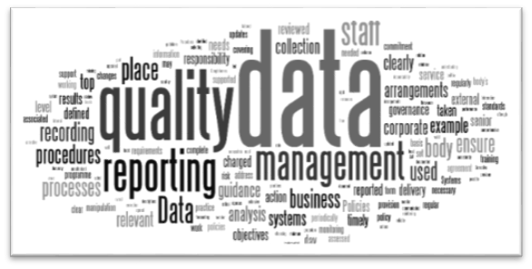
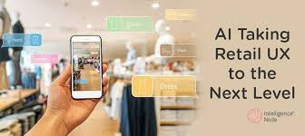
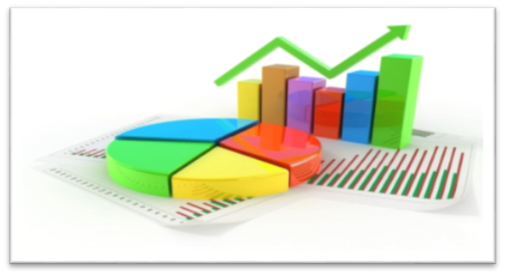
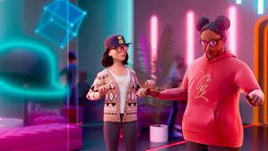
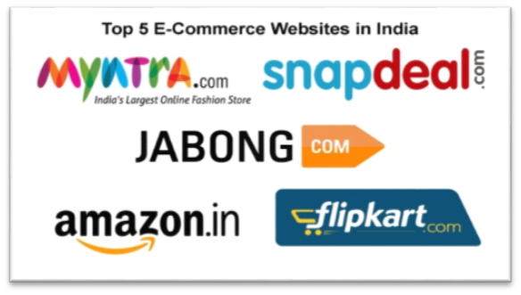
IT Applications for Fashion Business

Slide 7
Semester-wise Interdisciplinary Minors offered by DFT
IT Applications for Fashion Business
Semester 3 | Semester 4 | Semester 5 | Semester 6 | Semester 7
Data Management Techniques | Principles of Web Design | E-commerce in Fashion | ERP for Fashion Business | Introduction to Artificial Intelligence

Slide 8

IT Applications for Fashion Business
Sem-III :Data Management Techniques
Handling of business data for managing the information.
To provide digital based data management solutions to the management
Create business reports for decision making

Slide 9
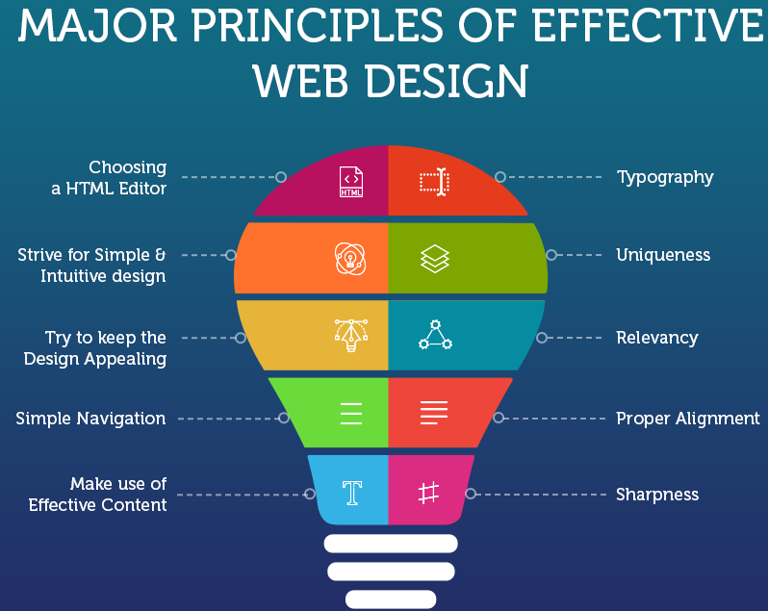
IT Applications for Fashion Business
Sem-IV :Principles of Web Design
Web design principles.
Create visual communications
Design and develop responsive website
Create web based portfolio
https://www.blazedream.com/blog/major-principles-of-effective-web-design/

Slide 10
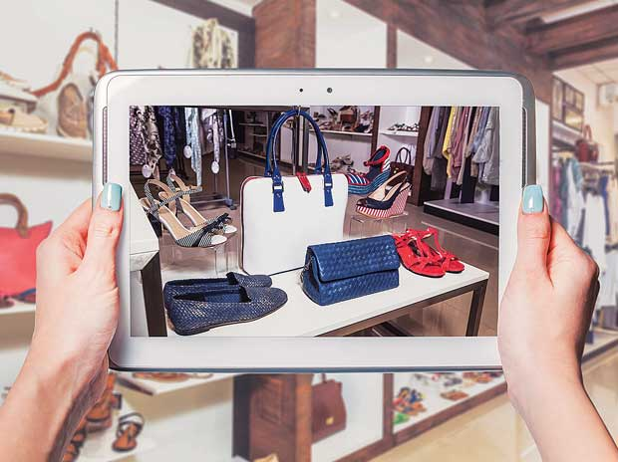
IT Applications for Fashion Business
Sem-V: E-commerce in Fashion
Converting physical retail business into multichannel including E-Commerce
Relevance of E-Commerce in current economic conditions and how future trade will be shaped by E-Commerce

Slide 11

IT Applications for Fashion Business
Sem-VI : ERP for Fashion Business
How various business functions are related by single software compared to separate MIS modules for CRM, SCM, PMM, HRM etc.
Use of ERP in Large scale Vs. Small scale manufacturing and
obtaining process efficiencies
Source :http://conceptable.com/fashion-technology-dilemma-need-erp-actually-need-manageable-business/

Slide 12
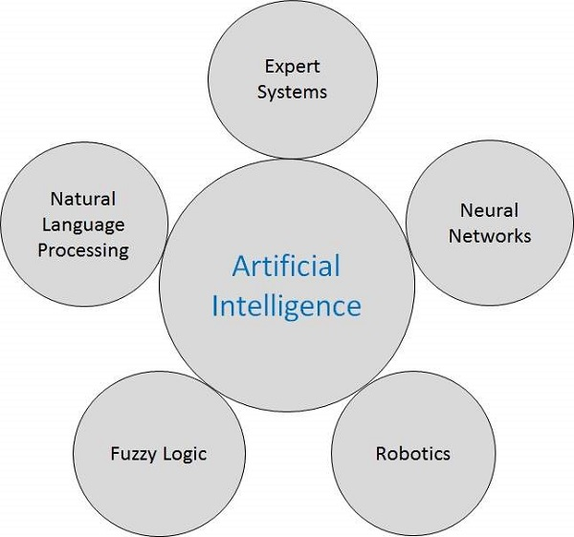
IT Applications for Fashion Business
Sem-VII :Introduction to Artificial Intelligence
Automation in garment manufacturing
Automation in design
Robotics, 3D body scanning
Automation in Supply Chain Management and retailing
AI concepts and AI techniques
Decision Support Systems
Advanced Intelligent Systems in design, management and technology

Slide 13
Thank You

